Slide 1

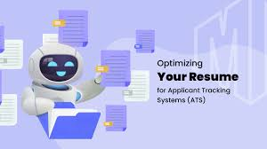
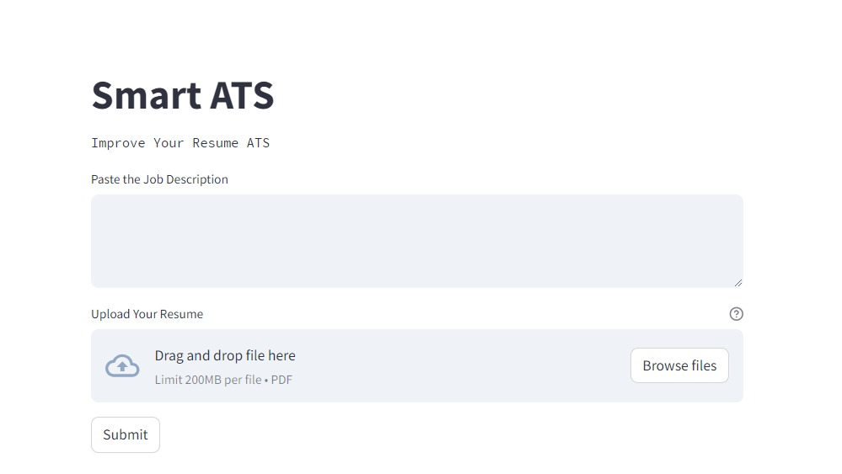
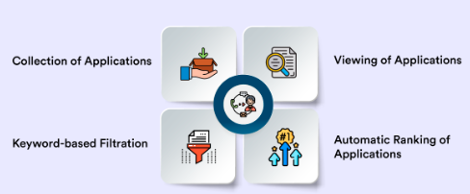
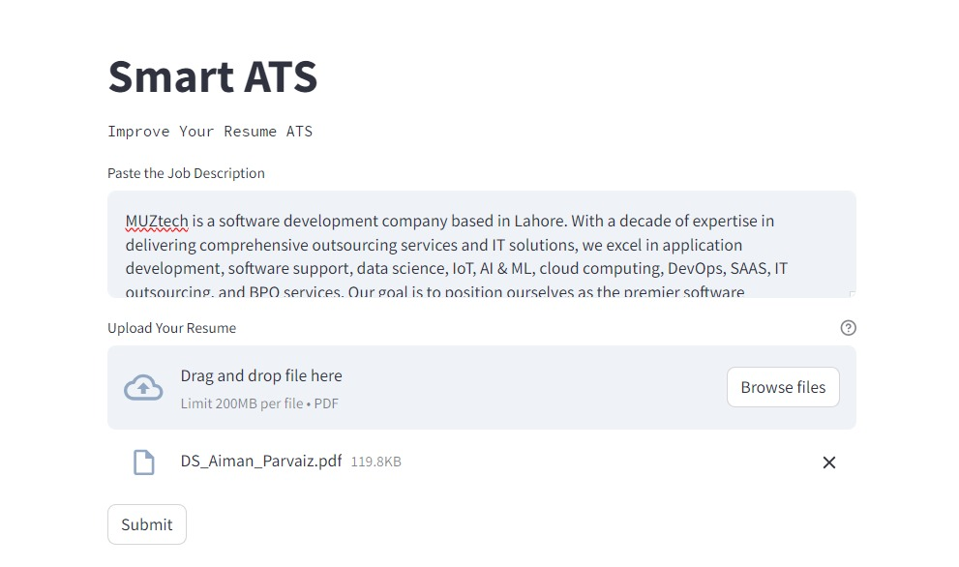
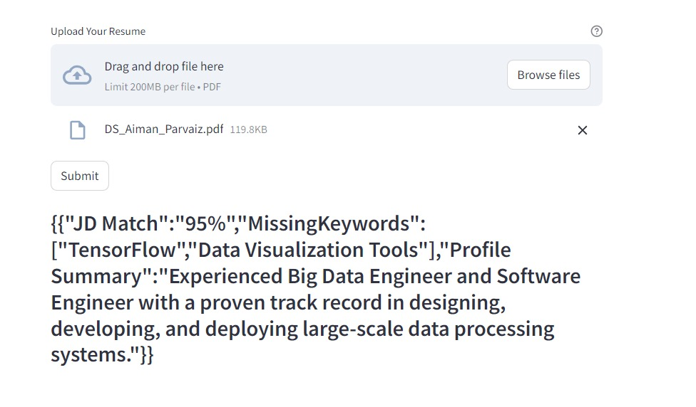
Applicantion Tracking System (ATS)
Aiman Parvaiz, Aqsa Majeed
Data Science
Knowledge Streams
1. Motivation
2. Problem Statement
The candidates can check their resumes before applying and improve their visibility and ranking.
Optimization for Keywords
Enhance visibility
Improving ranking
Increasing competitiveness
Candidates often struggle with ATS because their resumes might not be formatted correctly for the system to read, leading to their applications being overlooked. Additionally, they may feel like their applications disappear into a black hole, with little communication or feedback from employers.
Challenges:
PDF parsing accuracy
Data Extraction Robustness
Data Quality and Integrity
Scalability and performance
Regulatory compliance and security
3. Proposed Solution
4. Methodology
Automated Tracking Systems (ATS) are software used by employers to manage job applications.
To optimize your resume for ATS, consider using keywords from the job description, formatting it properly, and avoiding graphics.
Ensure your resume accurately reflects your skills and experiences. Our ATS can help you check your resume for ATS compatibility before submitting it for a job.
Tailor resumes to match job keywords and requirements.
Optimize with relevant skills and experiences.
Increase chances of ATS notice and progression in hiring.
Format resumes with clear headers, bullet points, and standard fonts.
Ensure ATS-friendly layout for improved readability.
Proactive approach enhances visibility and success in applications.
5. Results

